Slide 1
程式設計實習(一)

Slide 2
Pointer
address-of operator(取址運算子): &
取得變數的儲存位址.
indirection operator(間接運算子):*
用在指標變數以存取指標所指向之記憶位置的內容.

Slide 3
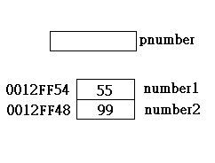
Pointer
…
long* pnumber;
long number1 = 55L;
long number2 = 99L;
pnumber = &number1;
*pnumber += 11;
cout << "number1 = "<< number1
<< " &number1 = "<< pnumber
<< endl ;
pnumber = &number2;
number1 = *pnumber *10;
cout << "number1 = "<< number1
<< " pnumber = "<< pnumber
<< " *pnumber = "<< *pnumber
<< endl ;
…

Slide 4
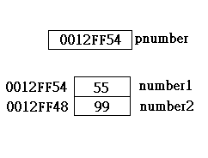
Pointer
…
long* pnumber;
long number1 = 55L;
long number2 = 99L;
pnumber = &number1;
*pnumber += 11;
cout << "number1 = "<< number1
<< " &number1 = "<< pnumber
<< endl ;
pnumber = &number2;
number1 = *pnumber *10;
cout << "number1 = "<< number1
<< " pnumber = "<< pnumber
<< " *pnumber = "<< *pnumber
<< endl ;
…

Slide 5
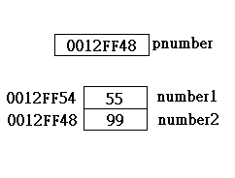
Pointer
…
long* pnumber;
long number1 = 55L;
long number2 = 99L;
pnumber = &number1;
*pnumber += 11;
cout << "number1 = "<< number1
<< " &number1 = "<< pnumber
<< endl ;
pnumber = &number2;
number1 = *pnumber *10;
cout << "number1 = "<< number1
<< " pnumber = "<< pnumber
<< " *pnumber = "<< *pnumber
<< endl ;
…

Slide 6
Pointer
…
long* pnumber;
long number1 = 55L;
long number2 = 99L;
pnumber = &number1;
*pnumber += 11;
cout << "number1 = "<< number1
<< " &number1 = "<< pnumber
<< endl ;
pnumber = &number2;
number1 = *pnumber *10;
cout << "number1 = "<< number1
<< " pnumber = "<< pnumber
<< " *pnumber = "<< *pnumber
<< endl ;
…

Slide 7
Hw 6
Input
A string(terminated by #).
Output
The words that sorted(using pointer) and
original.
Need sub-function

Slide 8
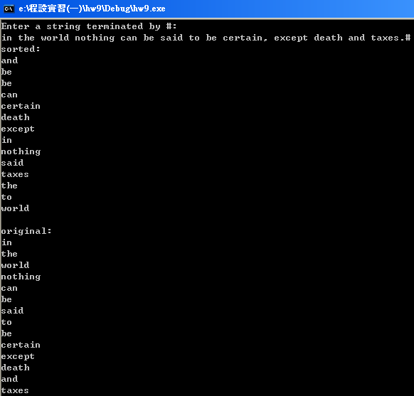
Hw 6

